Slide 1
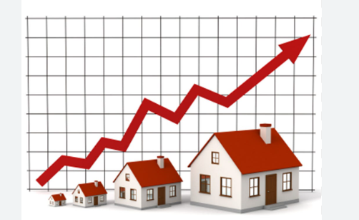
House Price Prediction
using Machine Learning in Python
By, Anuja Verma

Slide 2
Abstract
House Price Index (HPI) is commonly used to estimate the changes in housing price. Since housing price is strongly correlated to other factors such as location, area, population, it requires other information apart from HPI to predict individual housing price. There has been a considerably large number of papers adopting traditional machine learning approaches to predict housing prices accurately, but they rarely concern about the performance of individual models and neglect the less popular yet complex models. As a result, to explore various impacts of features on prediction methods, this paper will apply both traditional and advanced machine learning approaches to investigate the difference among several advanced models. This paper will also comprehensively validate multiple techniques in model implementation on regression and provide an optimistic result for housing price prediction.

Slide 3
Aim
The aim of house price prediction is to estimate the potential selling price of a property based on various factors. This is crucial for buyers, sellers, and investors in making informed decisions about the real estate market. House price prediction helps buyers find affordable homes, sellers set competitive prices, and investors identify profitable opportunities.
These are the Parameters on which we will evaluate ourselves -
Create an effective price prediction model
Validate the model's prediction accuracy
Identify the important home price attributes which feed the model's predictive power.

Slide 4
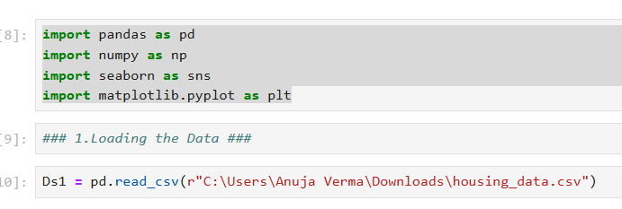
Implementation
Step Involved :
Importing the required packages in our python environment.
Importing data - Set

Slide 5
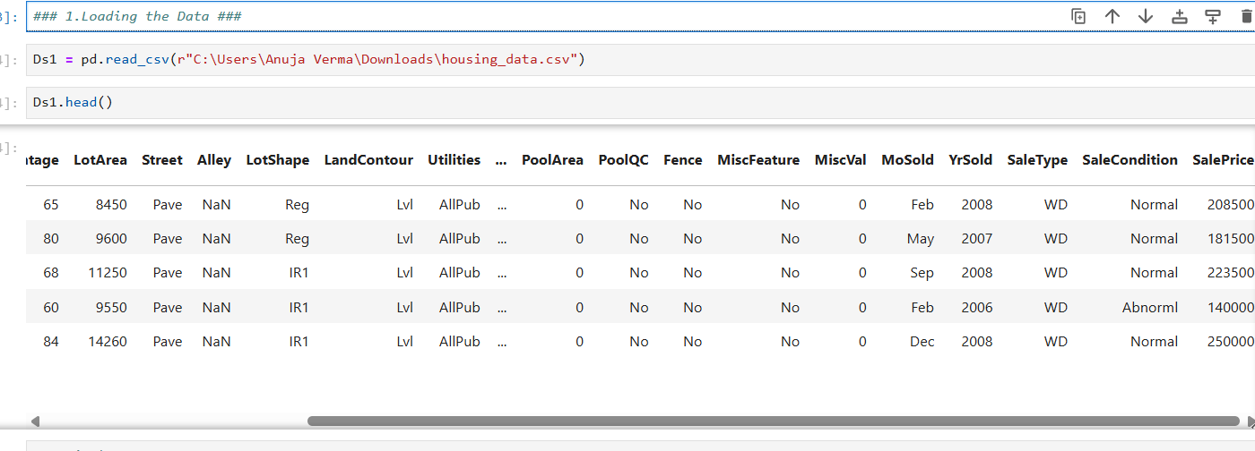
Data Selection
Data selection is defined as the process of determining the appropriate data type and source, as well as suitable instruments to collect data.Data selection precedes the actual practice of data collection.

Slide 6
Data visualization
Data visualization is the graphical representation of information and data. By using visual elements like charts,graphs, and maps , data visualization tools provide an accessible way to see and understand trends, outliers, and patterns in data. In the world of big Data, data visualization tools and technologies are essential to analyse massive amounts of information and make data-driven decisions.
Exploratory Data Analysis
Refers to the deep analysis of data so as to discover different patterns and spot anomalies. Before making inferences from data it is essential to examine all your variables. we can infer from above describe function that the dataset has a house where the house and would be interesting to know more about it as we progress.
Maximum square feet is 16200 where as the minimum is 1650.we can see that the data is distributed.

Slide 7
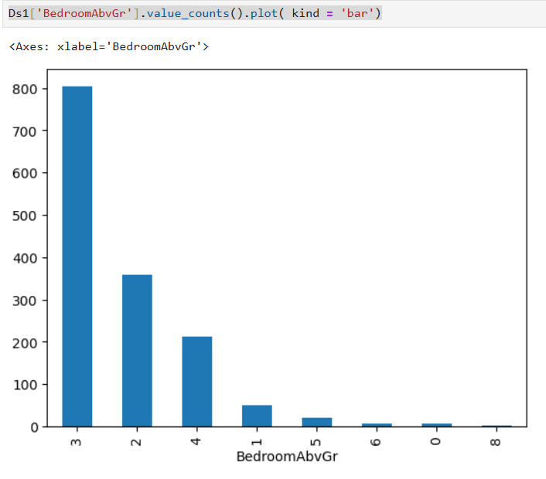
As we can see from the visualization 3 bedroom house are most commonly sold followed by 2 bedroom. So how is it useful? For a builder having this data , He can make a new building with more 2 and 3 bedroom's to attract more buyers.

Slide 8
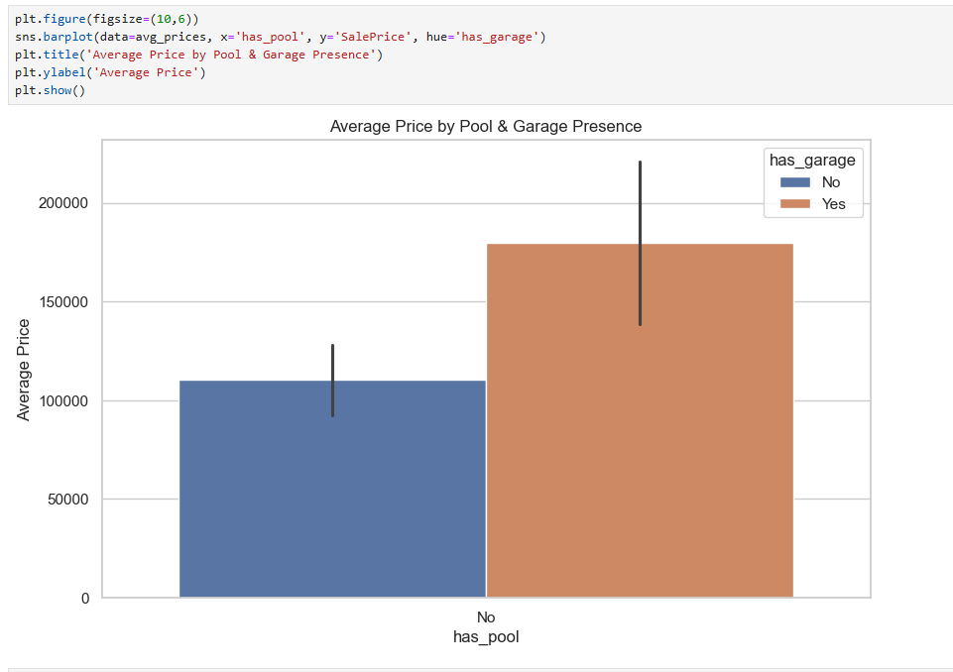
Form above we can see that house
which are Pool & garage will get Average
price

Slide 9
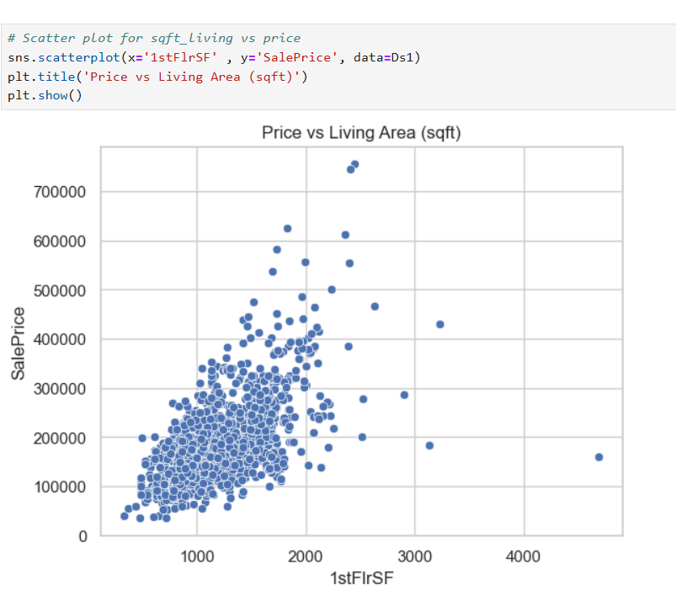
The pricing of the first floor square feet is shown in the chart.

Slide 10
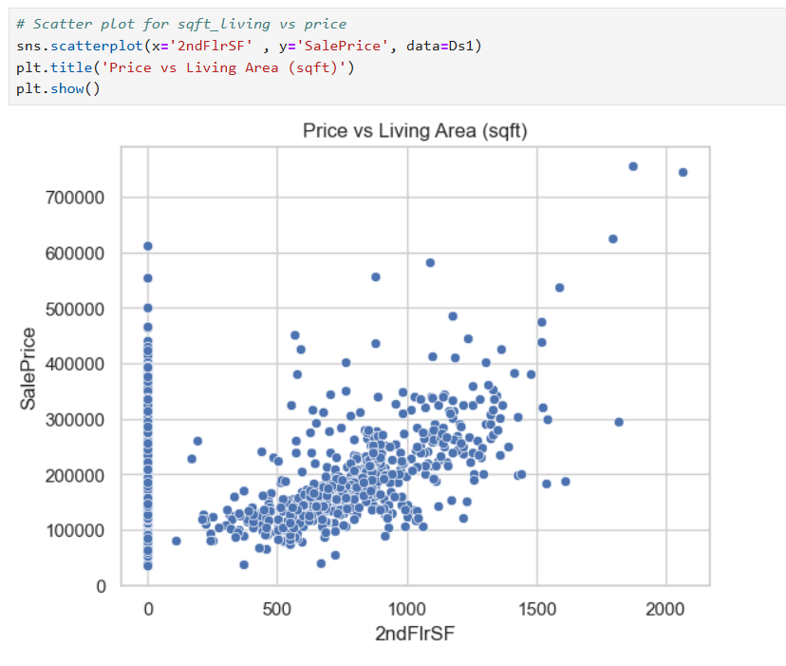
The pricing of the Seceond floor square feet is shown in the chart.

Slide 11
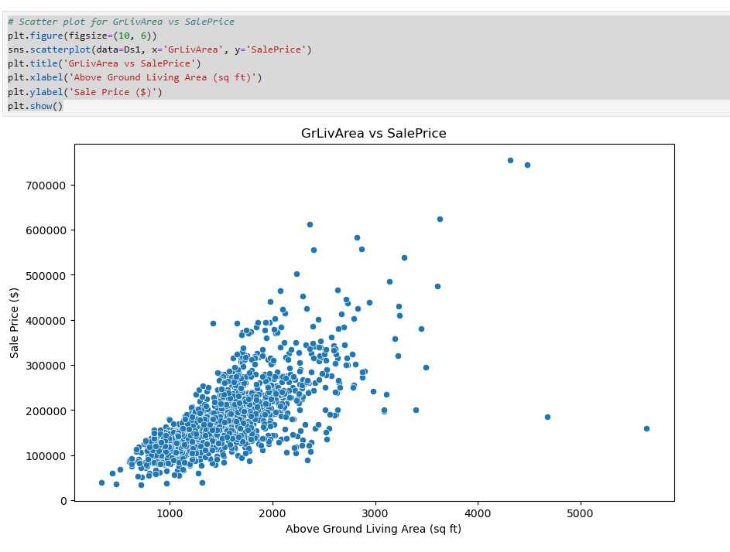

Slide 12
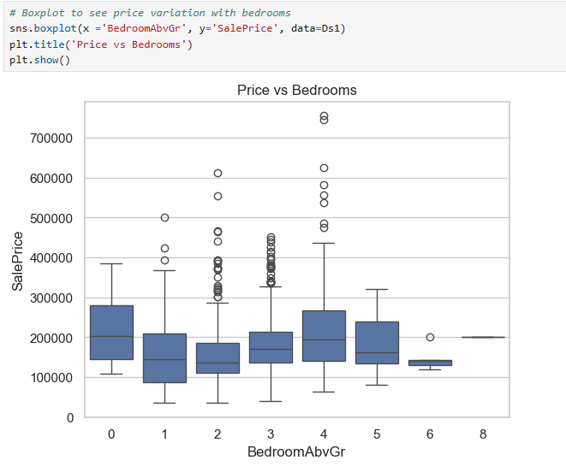

Slide 13
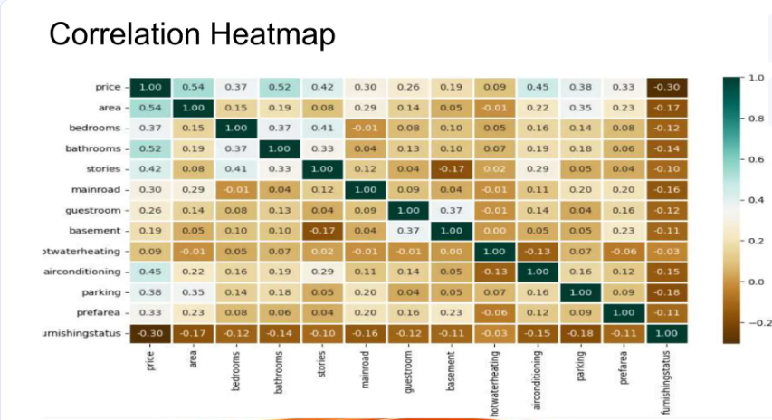

Slide 14
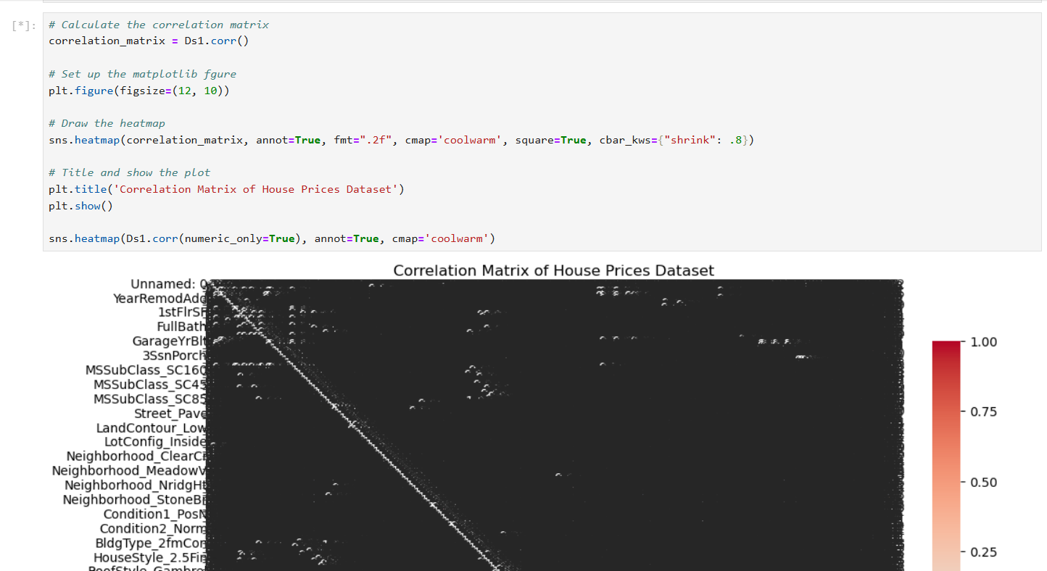

Slide 15
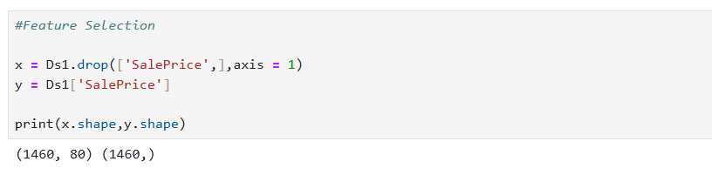
Feature Selection
Feature selection is a process that chooses a subset of feature from the original feature so that the feature space is optimally reduced according to a certain criterion.

Slide 16
Conclusion
So we conclude that the system that we proposed solves most of the problem that we have with the existing system. After training and testing of datasets with all models, the linear regression performs better than gradient boost regressor. The highest accuracy score is achieved by the linear regression. So , we suggest that this regression model be used for future house price predictions. Therefore. the outcome of our project will be predicting house prices with good accuracy which can help the customer as well as developer.

Slide 17
Thank You

